Slide 1
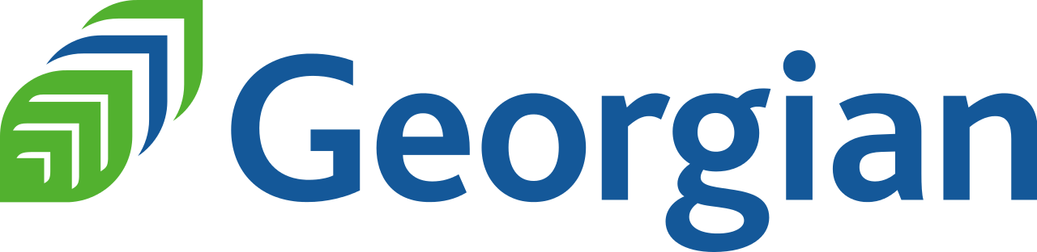
Information Encoding Standards-BDAT1001
IES Final Project - Group 3

Slide 2
Project Summary
The project is about authorization for individual users on the web app
Registered User: can delete and edit their own data and see approved users
Administrator: can approve/reject users and able to edit/delete any data
Manager: only allowed to approve contact data and only approved is visible
The Whole Project is based on the ASP.NET Core
Reference By Rick Anderson and Joe Audette

Slide 3
Group Information
Tanushka (200537994)
Team Lead
Mandeep Singh(200542624)
Developer
Raman Preet Singh (200544703)
Developer

Slide 4
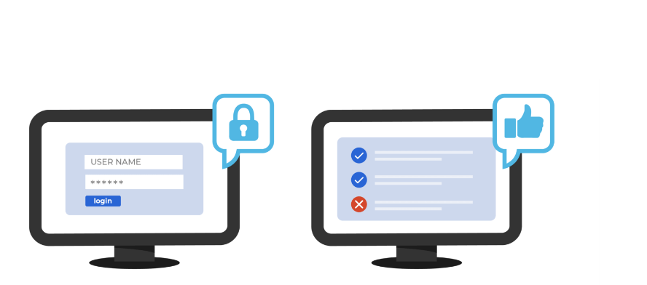
Authorization in ASP.Net Core Web App
ASP.NET Core provides built-in support for authentication and authorization, which makes it easy to implement security in your web application.
Authorization is the process of determining whether a user is allowed to access a particular resource or perform a particular action within the application.
The authentication middleware is responsible for handling user logins and issuing authentication tokens. The authorization middleware is responsible for checking whether a user is authorized to access a particular resource or perform a particular action.
Role-based authorization checks specify which roles which the current user must be a member of to access the requested resource.

Slide 5
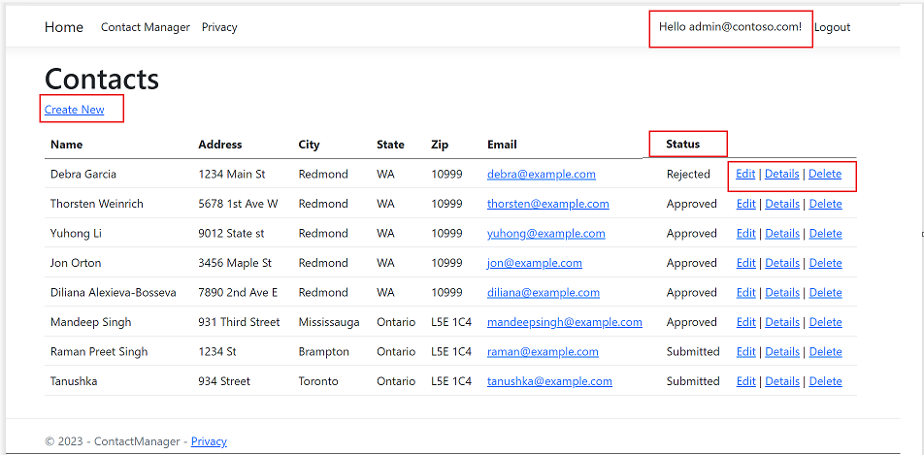
Admin View
Admin can create new Contacts
Logged in as Admin
Admin can see all the approved or rejected records
Admin can edit and delete all the data

Slide 6
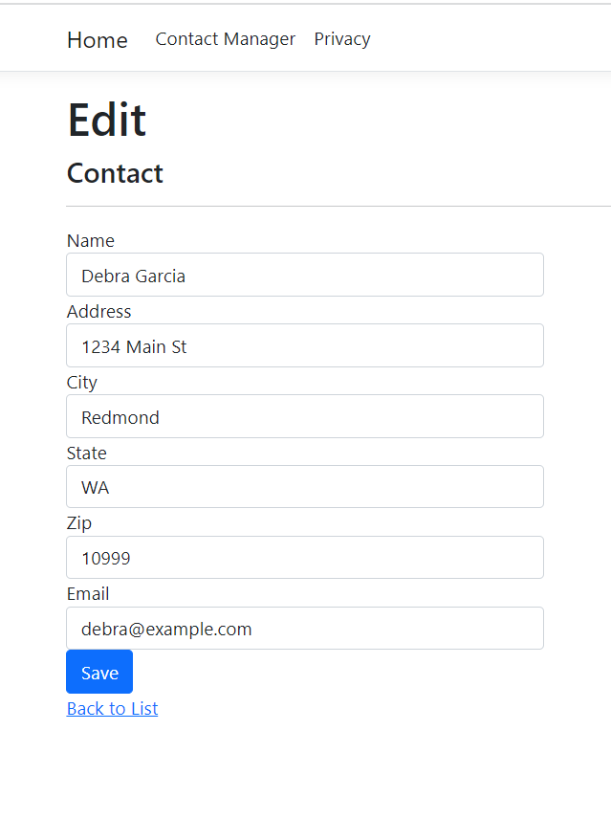
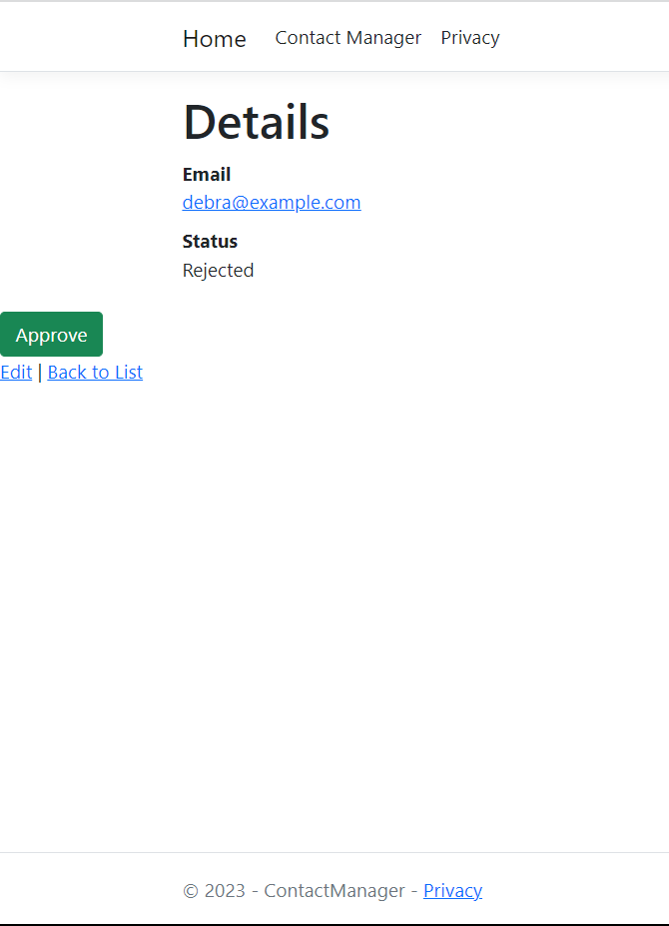
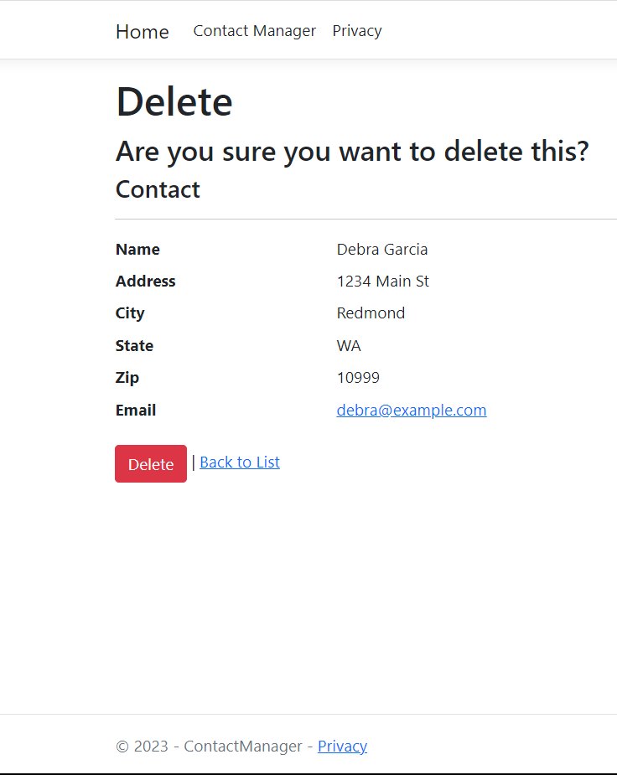
Edit, Details and delete view for Admin

Slide 7
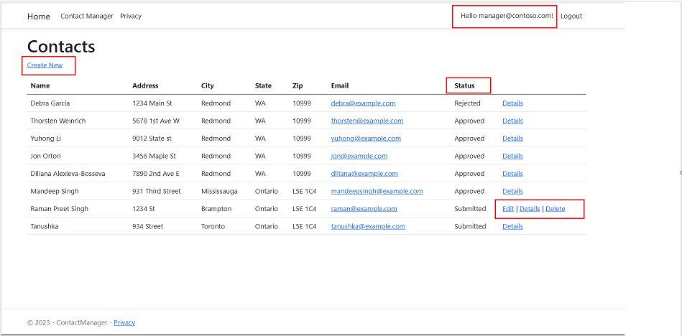
Manager View
Manager can create new contacts
Logged in as Manager
Manager can approve and reject the submitted contacts
Manager can only edit , view details or delete the records that he has created

Slide 8
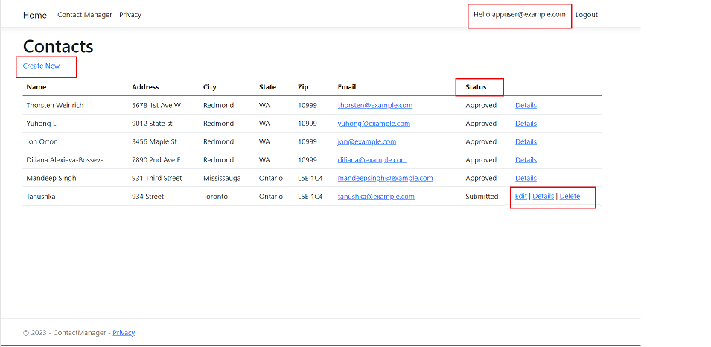
User View
Registered User can create new contacts
Logged in as Registered User
Registered User can only see the contacts records approved by admin or manger
Registered User can only edit , view details or delete the records that he has created

Slide 9
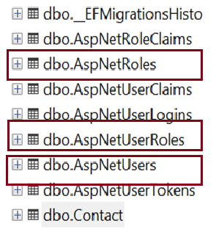
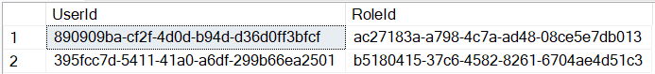
Database Tables

Slide 10
SECURITY TECHNOLOGIES RECOMMENDATIONS
How can we transfer personal data securely within their network?
There are several measures by which one can transfer data securely. Some of them are:
By implementing two-factor authentication and complex passwords that include a set of letters, numbers, and symbols.
Usage of access control to limit personal information access to specific users.
With the assistance of the encryption method, only the users who know to decrypt it, can get the data securely.
Firewalls restrict unauthorized access to the network.
Secure connections, HTTPS or VPN, protect the information by using encryption which disables the users to read the data.
Software should be frequently updated.
Provide appropriate knowledge to the users that what could be the repercussions of cyber-attacks and how much the security of the data matters.

Slide 11
SECURITY TECHNOLOGIES RECOMMENDATIONS
What security protocol is best for transferring personal files?
Encryption is used to protect the data from unauthorized users while transferring personal files. Here are some of the commonly used protocols:
SFTP (Secure File Transfer Protocol) is a secure version of FTP that encrypts the data during the transfer and large files can be easily shared with this protocol.
HTTP(Hypertext Transfer Protocol Secure) uses SSL to protect data that is transmitted over a network.
PGP uses public key cryptography to encrypt and decrypt data. It is considered the best way to send sensitive files.
VPN( Virtual Private Network) form a secure and encrypted connection between two devices and transfers the files between remote locations.
Generally, SFTP is recognized as the best protocol to transfer personal files securely as it is reliable to use and provides end-to-end encryption.

Slide 12
SECURITY TECHNOLOGIES RECOMMENDATIONS
Can we encode and encrypt images?
Yes, images can be encrypted as well as encoded. Encoding is the process by which an image can be converted into a different format, however, encryption converts the image into an unreadable form. For encrypting images, cryptographic algorithms i.e. AES or RSA can be used. For encoding an image, the base64 technique can be used which converts the binary image data into a format that could be easily stored in a database and transmitted over a network.

Slide 13
SECURITY TECHNOLOGIES RECOMMENDATIONS
Our database cannot be moved from the site and we need to be able to access it externally using a secure API. Can you explain the architecture of a secure API?
A secure API is one that uses security control protocols like SSL, and https to protect data in transit. This means that all data exchanged between the API client and server or database is encrypted and cannot be intercepted by third parties. In addition, a secure API may also use authentication and authorization mechanisms to control who can access the API and what actions they can perform.
Generally, the architecture of a secure API involves some combination of the following:
Authentication: a process by which the client proves its identity to the server.
Authorization: a process by which the server decides whether the client is allowed to access the requested resource.
Encryption: a process by which the communication between client and server is protected from eavesdropping.
There are many ways to implement authentication and authorization. An API key a common approach is a one-of-a- kind identifier that is used to verify a user's identity. When a user makes a request to the API, they include their API key in the request. The API then uses the API key to look up the user's permissions and determine whether or not to allow the user to access the resource. Another popular method is to use OAuth, which is an open authorization standard. OAuth allows users to grant access to their resources to third-party applications without having to share their credentials. OAuth is often used by web applications to allow users to login using their existing account on another site, such as Facebook or Google.

Slide 14
SECURITY TECHNOLOGIES RECOMMENDATIONS
Can you recommend a secure framework for coding an API?
A secure framework is important for coding an API because it helps to protect the data that is being exchanged between the API and its users. It also helps to prevent unauthorized access to the API and its data. This helps to keep the data safe and secure, and prevents unauthorized individuals from accessing it.
OAuth 2.0 is a popular secure framework for coding APIs. It allows users to securely access data and services from third-party applications. OAuth 2.0 is an open authorization standard that allows third-party applications to access data from a user's account without requiring the user's permission. OAuth 2.0 is commonly used by social media platforms and applications to grant access to user data.
OpenID Connect is another popular secure framework for coding APIs. It allows users to securely login to third- party applications using their existing identity providers. OpenID Connect is an extension of the OAuth 2.0 standard that allows for the exchange of user identity information. OpenID Connect allows for Single Sign-On (SSO), meaning that a user can login to multiple applications with one set of credentials.
SAML 2.0 is another popular secure framework for coding APIs. It allows users to securely exchange information between applications. SAML 2.0 is an open standard based on XML that allows parties to exchange authentication and authorization data. SAML 2.0 is often used by enterprises to grant access to resources to employees and partners.

Slide 15
SECURITY TECHNOLOGIES RECOMMENDATIONS
What data interchange format should we use while transferring data between locations?
Extensible markup language (XML) offers a set of rules for encoding text in a human- and machine-readable format. XML is often used for storing and transporting data, especially when there is a need to exchange data between different systems.
JavaScript Object Notation (JSON) is a data storage and transmission format that is widely used. It is a simple to read and write format based on a subset of the JavaScript programming language. JSON is often used in AJAX applications, and it is also a popular format for storing data in NoSQL databases.
Comma-Separated Values (CSV) is a common data storage format. CSV files are easy to read and write, and they can be opened in text editors and spreadsheet programs.

Slide 16
SECURITY TECHNOLOGIES RECOMMENDATIONS
How should we store our data in our many locations?
It is important to have a backup plan in place in case of data loss. This way, if data is accidentally deleted or lost, it can be retrieved from the backup.
Store data in a variety of formats (e.g. text, images, video, etc.) to ensure that it can be accessed by different devices and software. This way, if one format is not compatible with a certain device or software, another format can be used instead.
Use cloud storage solutions to make it easier to access data from multiple locations. Cloud storage allows data to be accessed from anywhere with an internet connection, which is convenient for users who need to access data from multiple locations.
Keep security in mind when storing data in multiple locations, and make sure to encrypt sensitive information. This will help to protect the data from being accessed by unauthorized individuals.

Slide 17
SECURITY TECHNOLOGIES RECOMMENDATIONS
What are the ethical concerns related to the transmission of personal data?
Data confidentiality is a concern because personal data may contain sensitive information like social security numbers that should not be shared with unauthorized individuals.
Data accuracy is a concern because personal data may be inaccurate or out-of-date. This can lead to individuals being misidentified or receiving inaccurate information. Because personal data might be accessed by unauthorized parties, data security is an issue. This can lead to the unauthorized use of personal data or the loss or theft of personal data.
Data privacy is a concern because personal data may be used for unauthorized purposes. This includes using personal data for marketing purposes or selling personal data to third parties.
There are a number of recommendations for addressing ethical concerns related to the transmission of personal data. These include ensuring that personal data is correct and up-to-date, that personal data is only shared with authorized personnel, and that personal data is only used for the purposes for which it was collected.

Slide 18
Thank You
ANY QUESTIONS?

